Slide 1

Peergrader June 5, 2024
Christian Knab, Aastha Verma, Eric Chuang, Eliah Reeves

Slide 2

01
What’s Peergrader?

Slide 3
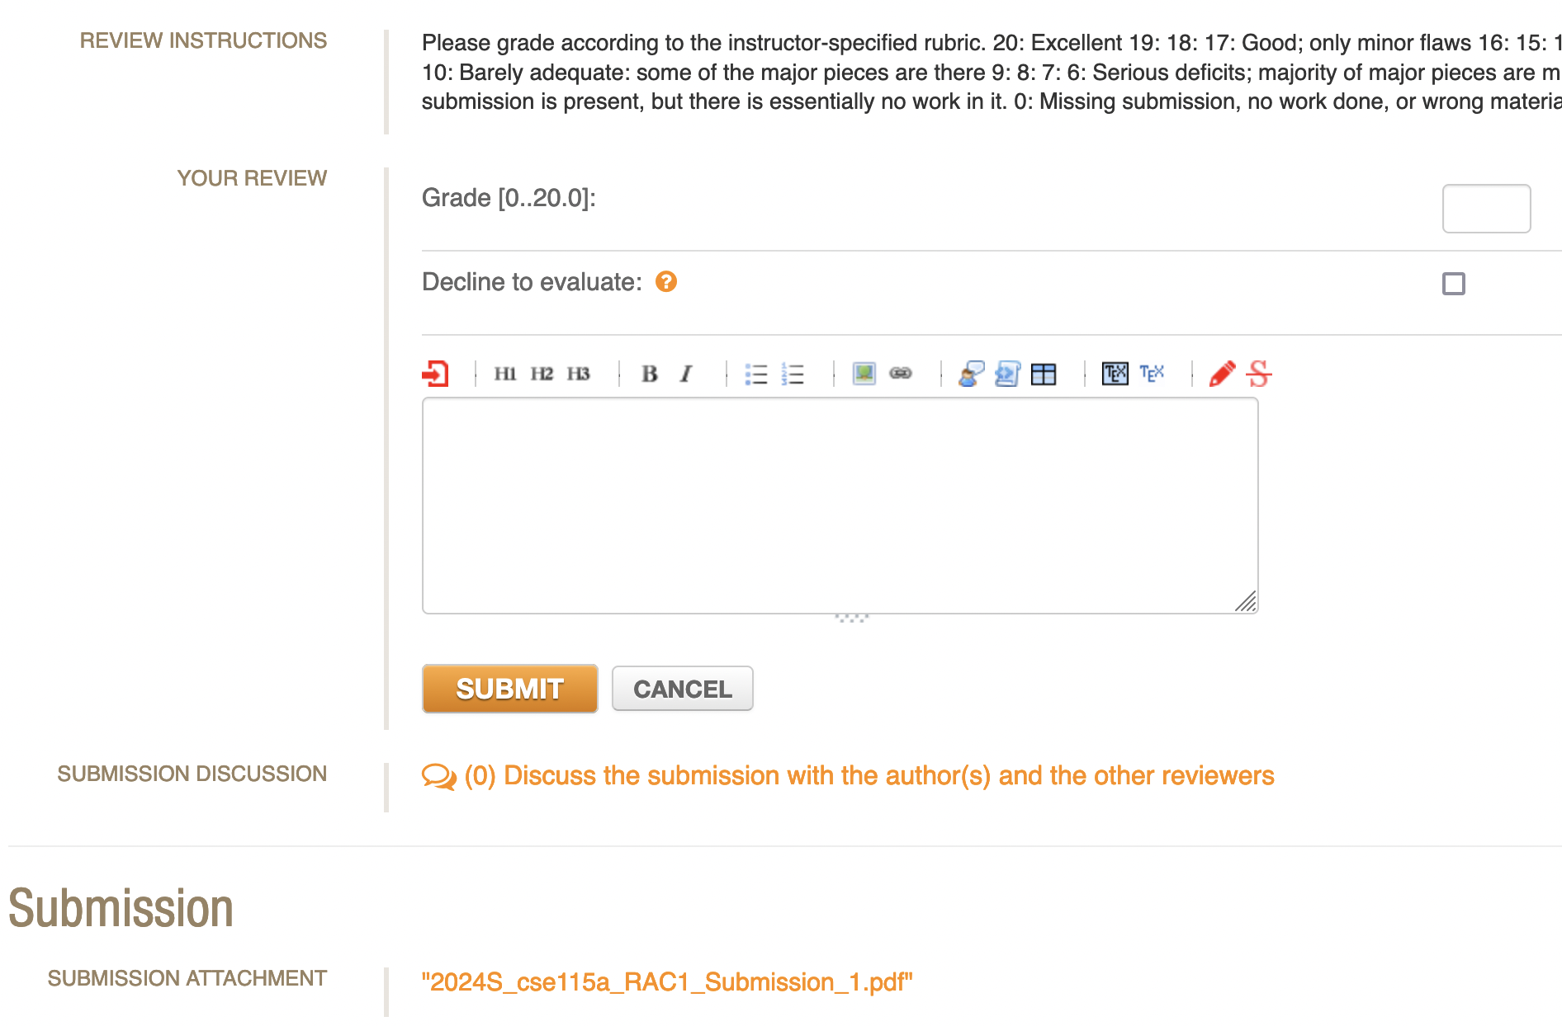
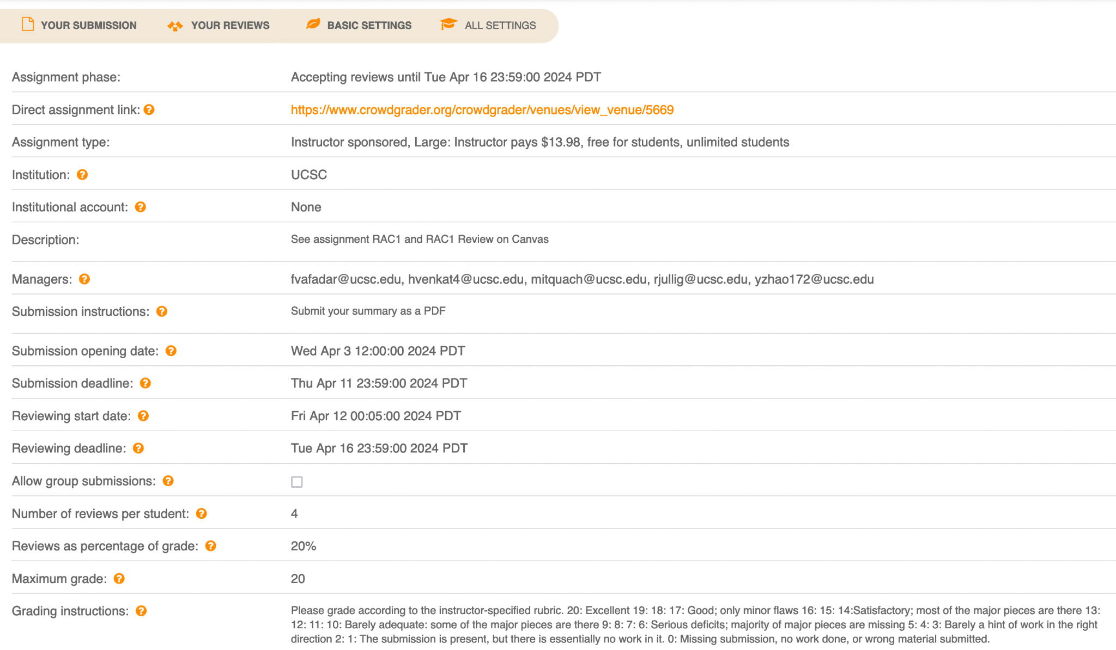
Current Product

Slide 4
Our Solution
Professors
Students
Professors don’t have the bandwidth to grade hundreds of students
Provide a cheap, modern design, with integration to Canvas gradebook for easy grade publishing
Students don’t like the current tool, Crowdgrader
A more intuitive interface increases usability and confidence about submissions & grading

Slide 5

High Level Goals
Original
Achieved
Students
join class
submit assignments
grade peers
receive grade
Instructors
create & customize course
invite students & restrict enrollment
create & customize assignments
sync grades to Canvas
Clean and intuitive design
Students
join class
submit assignments
grade peers
receive grade
Instructors
create & customize course
invite students & restrict enrollment
create & customize assignments
sync grades to Canvas
Clean and intuitive design

Slide 6

Biggest Challenges
Technical:
Learning Next.js
Best practices
How to write clean code
Efficiency
Caching data
Security
Logistic:
Task management
Used Github issues & Google doc
Working with conflicting priorities (other classes)

Slide 7

02
Demo

Slide 8
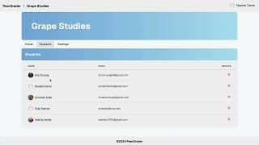

Slide 9
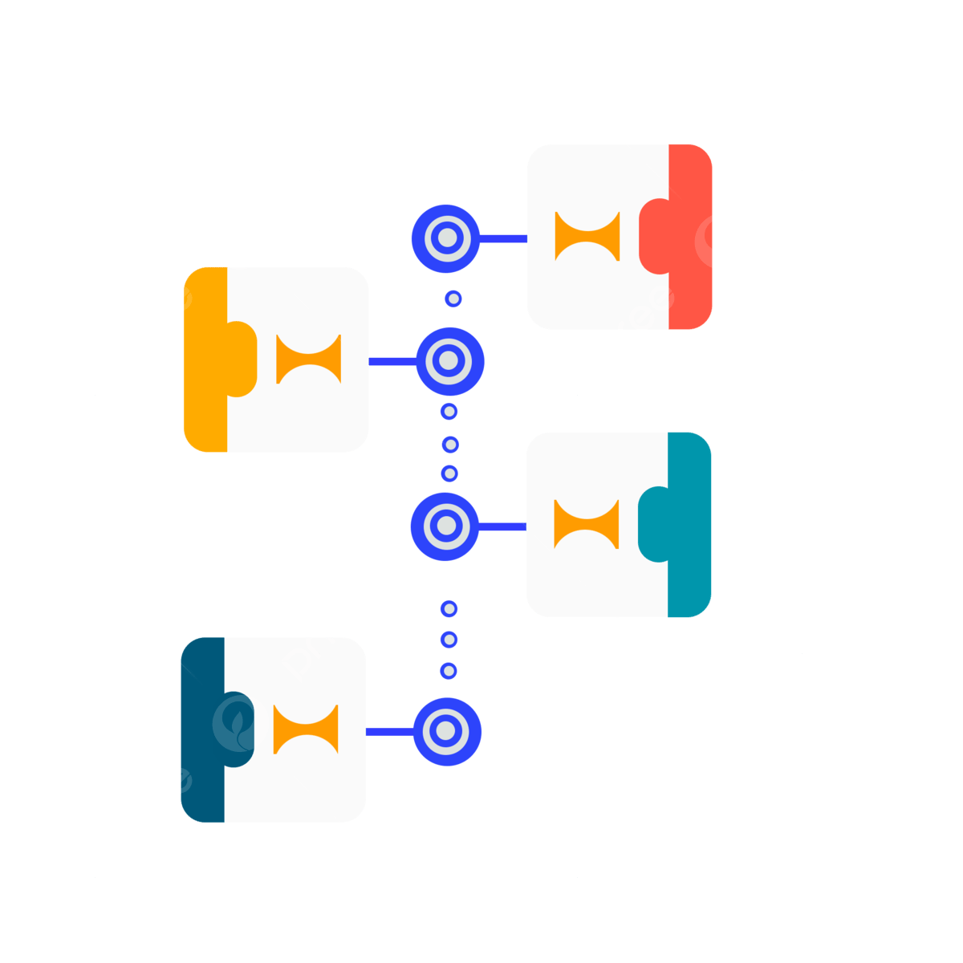
03
Website Outline

Slide 10
Create Course
Assignment
Home
Asgn.
Table
Instructor Dashboard
Course
Students
Student Grades
Login /
Signup
Profile
Settings
Export Grades
Student Dashboard
Student Course
Submit
Grade
Assignment
Join Course
Review

Slide 11
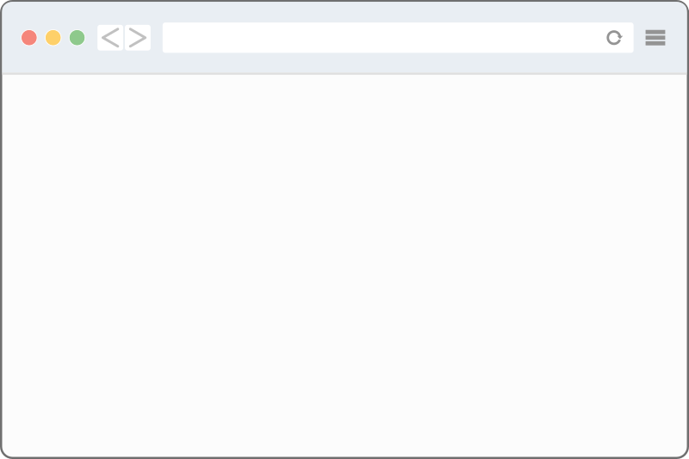

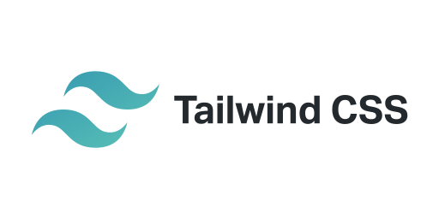
Technologies
Server - Supabase
Frontend
User
Storage
PostgreSQL
Web browser
Auth

Slide 12

04
Looking Back…

Slide 13



Project Management Techniques
GitHub Issues
ToDo List
Group Chat
Track bugs found
Request changes we wanted someone else to make
List all tasks to accomplish
Keep track of other member’s progress
Ask quick questions about bugs, UI changes, ask to look at something

Slide 14
Things we…
Enjoyed
Did Not Enjoy
Gaining web development experience
Learning how to use widely used technologies
Experience working in a group
Merging conflicts
Working around other class priorities
Learning curve of a new technology and rewriting old, bad code
Resolving deployment issues not present in dev builds

Slide 15
Lessons Learned
Keep Doing
Didn’t Work
Wished we did
Split work across different tasks that do not conflict
Split work between frontend and backend
Consistently updating each other about our next tasks to avoid overlap
Not prioritizing core functionality
Prioritizing completing user stories over writing quality code
Not fully completing features
Documented code as we wrote it
Wrote more detailed task lists to remember unfinished work
More UI designs so implementation is easier
Created a style guide

